Slide 1


SOFTWARE Design & Analysis (Week-16)
Usama Musharaf
MS-CS (Software Engineering)
Lecturer (Department of Computer Science)
FAST-NUCES Peshawar

Slide 2
Agenda of Week # 16
Behavioral Patterns
Chain of Responsibility
Command
Interpreter
Iterator
Mediator
Memento
Observer
State
Strategy
Template Method
Visitor

Slide 3
Strategy Design Pattern (Behavioral pattern)

Slide 4
Strategy Design Pattern
Defines a family of algorithms, encapsulates each one, and make them interchangeable,
This is really helpful if you have many passible variations of an algorithms.

Slide 5
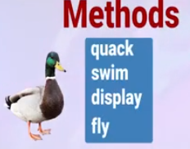

Strategy Design Pattern (Example)

Slide 6


Strategy Design Pattern (Example)

Slide 7
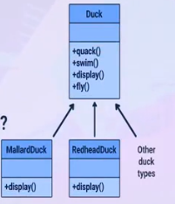
Strategy Design Pattern (Example)
Add fly()
What about rubber duck or wooden duck?

Slide 8
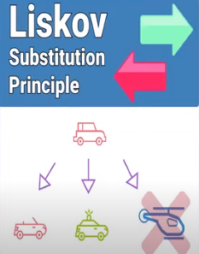
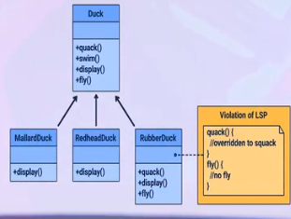
Strategy Design Pattern (Example)

Slide 9
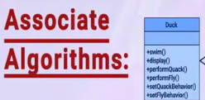
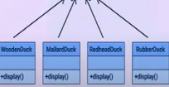
Solution
Quack Behavior
Quack()
Fly Behavior
Fly()

Slide 10
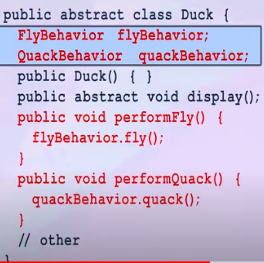
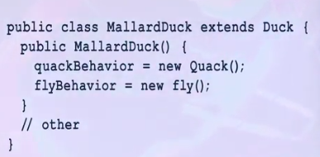
solution

Slide 11
State Design Pattern (Behavioral pattern)

Slide 12
State Design Pattern
State pattern allows an object to alter its behavior when its internal state changes.
This pattern allows to define state-specific behaviors in separate classes.
A benefit of this pattern is that new states and thus new behaviors can be added without changing our main class.

Slide 13
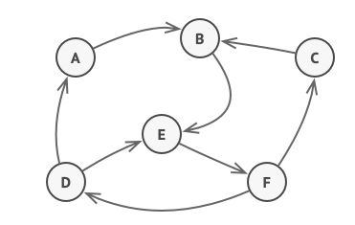
State Design Pattern
The State pattern is closely related to the concept of a Finite-State Machine.

Slide 14
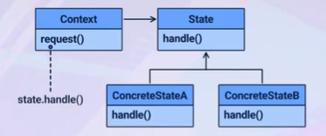
State Design Pattern
State Design Pattern Structure

Slide 15
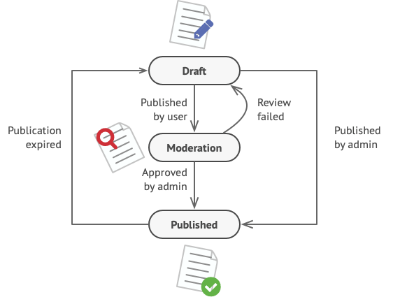
State Design Pattern

Slide 16
State Design Pattern
class Document is
switch (state)
"draft":
state = "moderation"
break
"moderation":
if (currentUser.role == 'admin')
state = "published"
break
"published":
// Do nothing.
break
// ...

Slide 17
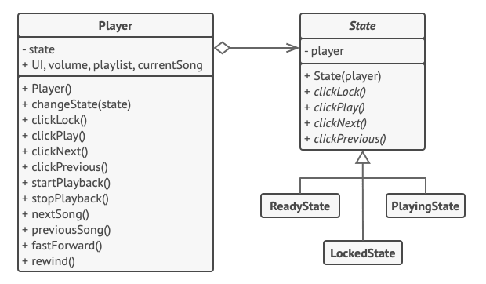
State Design Pattern

Slide 18
Lets Code

Slide 19
Chain of Responsibility (Behavioral pattern)

Slide 20
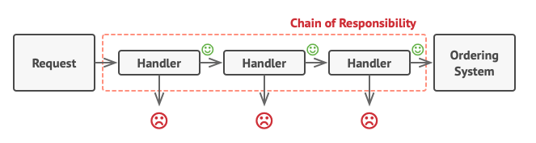
Chain of Responsibility Design Pattern
Chain of Responsibility is a behavioral design pattern that lets you pass requests along a chain of handlers.
Upon receiving a request, each handler decides either to process the request or to pass it to the next handler in the chain.

Slide 21
Chain of Responsibility Design Pattern
Diagram of Leave Processing Application
Leave
Client
Leave Approver
Employee
Lead
Manager
Director

Slide 22
Lets Code

Slide 23
HAVE A GOOD DAY!

